Slide 1
Bird Infographics
Here is where this template begins

Slide 2
Bird Infographics
01
01
02
Venus
Mars
Venus has a very beautiful name and is the second planet
Despite being red, Mars is a cold place full of iron oxide dust
02
25 %
75 %

Slide 3
Bird Infographics
Mercury | Mars | Jupiter | Venus
Mercury is the closest planet to the Sun | Despite being red, Mars is a very cold place | Jupiter is a gas giant and the biggest planet | Venus is the second planet from the Sun

Slide 4
Bird Infographics
01
02
Neptune
Earth
Neptune is the farthest planet from the Sun
Earth is the only planet that harbors life
03
04
Pluto
Jupiter
Pluto is now considered a dwarf planet
Jupiter is the biggest planet in the Solar System
05
06
Ceres
Mars
Ceres is located in the main asteroid belt
Despite being red, Mars is a cold planet

Slide 5
Bird Infographics
Mercury
Saturn
Jupiter
Mercury is the smallest planet in the Solar System
Saturn is composed mostly of hydrogen and helium
Jupiter is a gas giant and the biggest planet of them all

Slide 6
Bird Infographics
Mercury
Neptune
Mercury is the closest planet to the Sun
Neptune is the farthest planet from the Sun
Venus
Pluto
Venus has a beautiful name, but it’s hot
Pluto is now considered a dwarf planet
Earth
Ceres
Earth is the only planet that harbors life
Ceres is located in the main asteroid belt

Slide 7
Bird Infographics
Mercury
Venus
It is the closest planet to the Sun and the smallest one in the Solar System
Venus has a beautiful name, but is also hot, even hotter than Mercury
Saturn
Mars
Saturn is a gas giant composed mostly of hydrogen and helium
Despite being red, Mars is a very cold place full of iron oxide dust

Slide 8
Bird Infographics
Mercury
Venus
Jupiter
It is the closest to the Sun and the smallest one
Venus is the second planet from the Sun
Jupiter is the biggest planet in the Solar System
20%
60%
80%

Slide 9
Bird Infographics
65%
Mercury
It is the closest planet to the Sun and the smallest one in the Solar System
40%
Venus
Venus has a beautiful name, but is also hot, even hotter than Mercury
55%
Saturn
Saturn is a gas giant composed mostly of hydrogen and helium

Slide 10
Bird Infographics
Mercury
01
55 %
It is the closest planet to the Sun and the smallest one in the Solar System
Saturn
02
35 %
Saturn is a gas giant composed mostly of hydrogen and helium
03
Venus
25 %
Venus has a beautiful name, but is also hot, even hotter than Mercury

Slide 11
Bird Infographics
Mercury is the closest planet to the Sun and the smallest one in the Solar System
Mercury
90%
Jupiter is a gas giant and also the biggest planet in the Solar System
Jupiter
45%
Saturn is a gas giant in the Solar System, composed mostly of hydrogen and helium
Saturn
75%
It has a beautiful name and is the second planet from the Sun
Venus
60%

Slide 12
Bird Infographics
Beak | Mercury is the closest planet to the Sun
Wings | Venus has a beautiful name, but it's hot
Feet | It’s the biggest planet in the Solar System
Beak | Despite being red, Mars is a cold place
Wings | Saturn is the ringed one and a gas giant
Feet | Neptune is the farthest planet from the Sun

Slide 13
Bird Infographics
Mercury
Mercury is the closest planet to the Sun and the smallest one
Mars
Despite being red, Mars is actually a very cold place
Neptune
Neptune is the farthest planet from the Sun
Saturn
Saturn is composed mostly of hydrogen and helium

Slide 14
Bird Infographics
Mercury
Venus
Jupiter
Mars
Mercury is the closest to the Sun and the smallest one
Venus has a very beautiful name and is the second planet
Jupiter is the biggest planet in the entire Solar System
Despite being red, Mars is a cold place full of iron oxide dust
01
02
03
04

Slide 15
Bird Infographics
1
Mercury
1
It is the closest planet to the Sun and the smallest one in the Solar System
2
Saturn
2
Saturn is a gas giant composed mostly of hydrogen and helium
3
Venus
3
Venus has a beautiful name, but is also hot, even hotter than Mercury

Slide 16
Bird Infographics
65%
40%
Mercury
Venus
It is the closest planet to the Sun and the smallest one in the Solar System
Venus has a beautiful name, but is also hot, even hotter than Mercury
55%
20%
Saturn
Earth
Saturn is a gas giant composed mostly of hydrogen and helium
Earth is the third planet from the Sun and the one where we live on

Slide 17
Bird Infographics
Mercury
Earth
Mercury is the closest planet to the Sun
Earth is the third planet from the Sun
Mars
Neptune
Despite being red, Mars is a cold place
Neptune is the farthest planet from the Sun
Jupiter
Saturn
Jupiter is a gas giant and the biggest planet
Saturn is composed of hydrogen and helium

Slide 18
Bird Infographics
10%
20%
Mercury
Jupiter
Mercury is the closest to the Sun and the smallest one
Jupiter is the biggest planet in the entire Solar System
30%
40%
Venus
Mars
Venus has a very beautiful name and is the second planet
Despite being red, Mars is a cold place full of iron oxide dust

Slide 19
Bird Infographics
Mercury
Jupiter
Mercury is the closest to the Sun and the smallest one
Jupiter is the biggest planet in the entire Solar System
Venus
Mars
Venus has a very beautiful name and is the second planet
Despite being red, Mars is a cold place full of iron oxide dust

Slide 20
Bird Infographics
70%
Venus has a beautiful name and is the second planet from the Sun. It’s terribly hot—even hotter than Mercury
30%
Mercury is the closest planet to the Sun and the smallest one in the Solar System—it’s a bit larger than the Moon

Slide 21
Bird Infographics
Mercury is the smallest planet of them all
1
Mercury
Saturn is a gas giant and has several rings
2
Saturn
Jupiter is the biggest planet of them all
3
Jupiter
Mars is a cold place. It is full of iron oxide dust
4
Mars

Slide 22
Bird Infographics
45%
55%
70%
95%
Mercury
Jupiter
Venus
Mars
Mercury is the closest to the Sun and the smallest one
Jupiter is the biggest planet in the entire Solar System
Venus has a very beautiful name and is the second planet
Despite being red, Mars is a cold place full of iron oxide dust

Slide 23
Bird Infographics
70%
Neptune
Neptune is the farthest planet from the Sun and a gas giant
40%
Mercury
Mercury is the closest planet to the Sun and the smallest one
90%
Mars
Despite being red, Mars is a cold place full of iron oxide dust
70%
Venus
Venus has a beautiful name, but it is even hotter than Mercury

Slide 24
Bird Infographics
Venus
Jupiter
02
03
Venus has a very beautiful name and is the second planet
Jupiter is the biggest planet in the entire Solar System
Mercury
Mars
01
04
Mercury is the closest to the Sun and the smallest one
Despite being red, Mars is a cold place full of iron oxide dust

Slide 25
Bird Infographics
10%
60%
75%
40%
25%
Mercury
Venus
Jupiter
Mars
Earth
It is the closest to the Sun and the smallest one
Venus is the second planet from the Sun
Jupiter is the biggest planet in the Solar System
Mars is a cold place full of iron oxide dust
Earth is the only planet in the Solar System with life

Slide 26
Bird Infographics
80%
45%
70%
60%
Jupiter
Mars
Venus
Saturn
Jupiter is a gas giant and the biggest planet in the Solar System
Despite being red, Mars is actually a cold place. It’s full of iron oxide dust
Venus has a beautiful name and is the second planet from the Sun
Saturn is a gas giant, composed mostly of hydrogen and helium

Slide 27
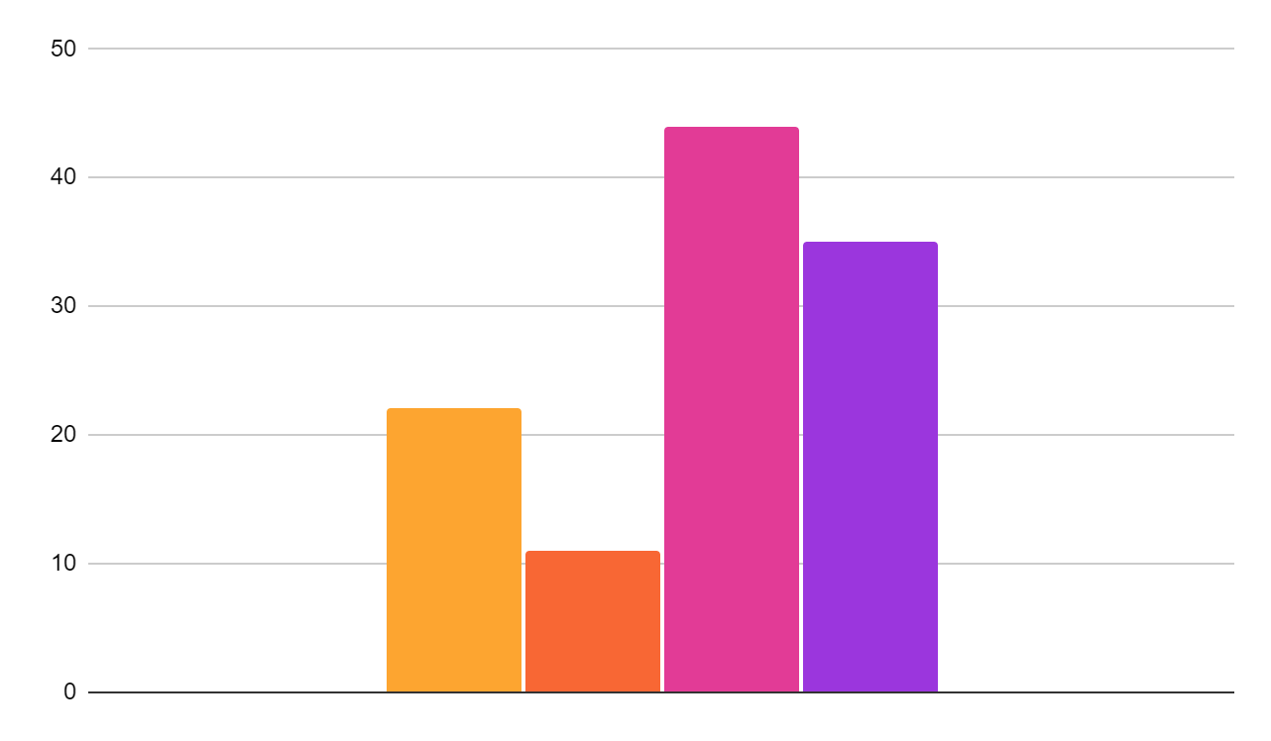
Bird Infographics
Mercury
Mercury is the closest planet to the Sun and the smallest one
Mars
Despite being red, Mars is actually a very cold place
Neptune
Neptune is the farthest planet from the Sun
Saturn
Saturn is composed mostly of hydrogen and helium
To modify this graph, click on it, follow the link, change the data and paste the new graph here

Slide 28
Bird Infographics
01
04
Mercury
Neptune
Mercury is the closest planet to the Sun
Neptune is the farthest planet from the Sun
02
05
Venus
Pluto
Venus has a beautiful name, but it’s hot
Pluto is now considered a dwarf planet
03
06
Earth
Ceres
Earth is the only planet that harbors life
Ceres is located in the main asteroid belt

Slide 29
Bird Infographics
Mercury
Jupiter
Earth
Mercury is the closest to the Sun and the smallest one
Jupiter is the biggest planet in the entire Solar System
Earth is the only planet in the Solar System with life
Venus
Mars
Saturn
Venus has a very beautiful name and is the second planet
Despite being red, Mars is a cold place full of iron oxide dust
Saturn is composed mostly of hydrogen and helium

Slide 30
Bird Infographics
Venus
Mars
Venus has a very beautiful name and is the second planet
Despite being red, Mars is a cold place full of iron oxide dust
Mercury
Jupiter
Mercury is the closest to the Sun and the smallest one
Jupiter is the biggest planet in the entire Solar System

Slide 31
Bird Infographics
Mercury is the closest planet to the Sun and the smallest one
1
Despite being red, Mars is actually a very cold place
2
Neptune is the farthest planet from the Sun
3
10%
40%
30%
20%
Saturn is composed mostly of hydrogen and helium
4
Mercury
Mars
Neptune
Saturn

Slide 32
Instructions for use
In order to use this template, you must credit Slidesgo and Freepik in your final presentation and include links to both websites.
You are allowed to:
- Modify this template.
- Use it for both personal and commercial projects.
You are not allowed to:
- Sublicense, sell or rent any of Slidesgo Content (or a modified version of Slidesgo Content).
- Distribute Slidesgo Content unless it has been expressly authorized by Slidesgo.
- Include Slidesgo Content in an online or offline database or file.
- Offer Slidesgo templates (or modified versions of Slidesgo templates) for download.
- Acquire the copyright of Slidesgo Content.
For more information about editing slides, please read our FAQs or visit Slidesgo School:
https://slidesgo.com/faqs and https://slidesgo.com/slidesgo-school

Slide 33
Instructions for use (premium users)
In order to use this template, you must be a Premium user on Slidesgo.
You are allowed to:
Modify this template.
Use it for both personal and commercial purposes.
Hide or delete the “Thanks” slide and the mention to Slidesgo in the credits.
Share this template in an editable format with people who are not part of your team.
You are not allowed to:
Sublicense, sell or rent this Slidesgo Template (or a modified version of this Slidesgo Template).
Distribute this Slidesgo Template (or a modified version of this Slidesgo Template) or include it in a database or in any other product or service that offers downloadable images, icons or presentations that may be subject to distribution or resale.
Use any of the elements that are part of this Slidesgo Template in an isolated and separated way from this Template.
Register any of the elements that are part of this template as a trademark or logo, or register it as a work in an intellectual property registry or similar.
For more information about editing slides, please read our FAQs or visit Slidesgo School:
https://slidesgo.com/faqs and https://slidesgo.com/slidesgo-school

Slide 34
Infographics
You can add and edit some infographics to your presentation to present your data in a visual way.
Choose your favourite infographic and insert it in your presentation using Ctrl C + Ctrl V or Cmd C + Cmd V in Mac.
Select one of the parts and ungroup it by right-clicking and choosing “Ungroup”.
Change the color by clicking on the paint bucket.
Then resize the element by clicking and dragging one of the square-shaped points of its bounding box (the cursor should look like a double-headed arrow). Remember to hold Shift while dragging to keep the proportions.
Group the elements again by selecting them, right-clicking and choosing “Group”.
Repeat the steps above with the other parts and when you’re done editing, copy the end result and paste it into your presentation.
Remember to choose the “Keep source formatting” option so that it keeps the design. For more info, please visit Slidesgo School.

